Slide 1
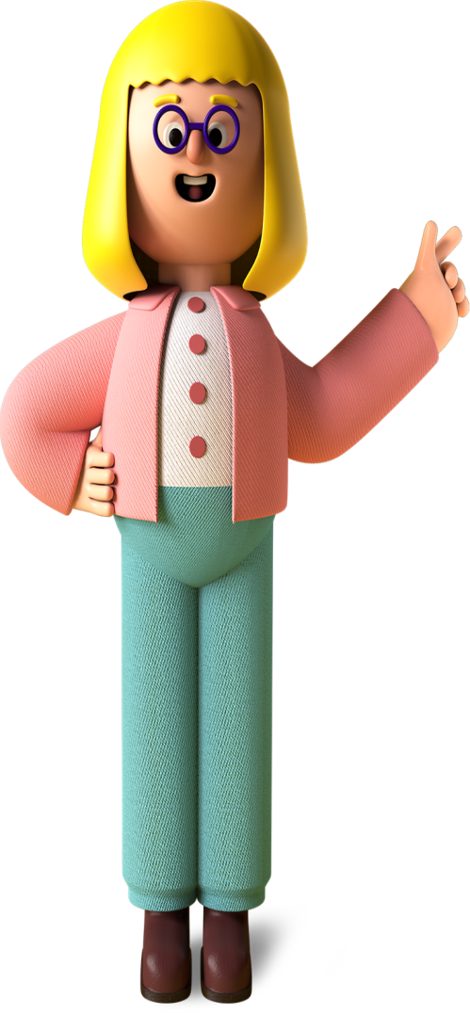
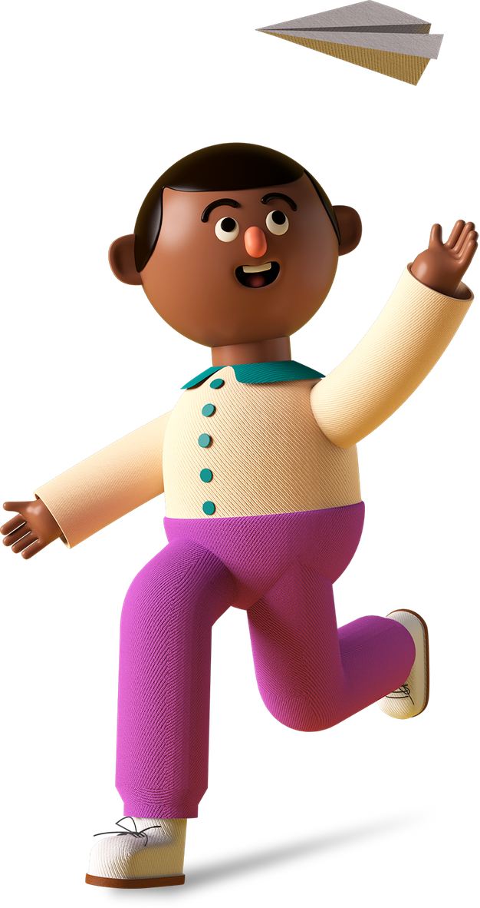

Student
Project

Slide 2

Project Name
Go Corona Go

Slide 3

Project Link
https://abhinavdas2006.github.io/Go-Corona-Go-Made-By-Abhinav-Final-Game/

Slide 4
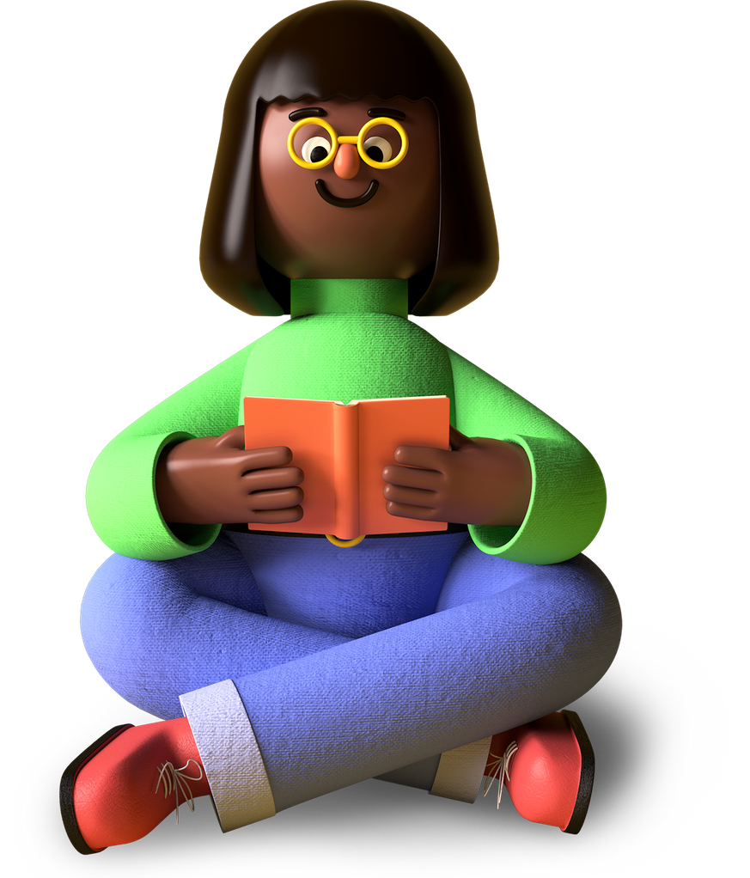
My favorite part about the project
Game based on reality
Engaging and fun
Game spreads awareness

Slide 5
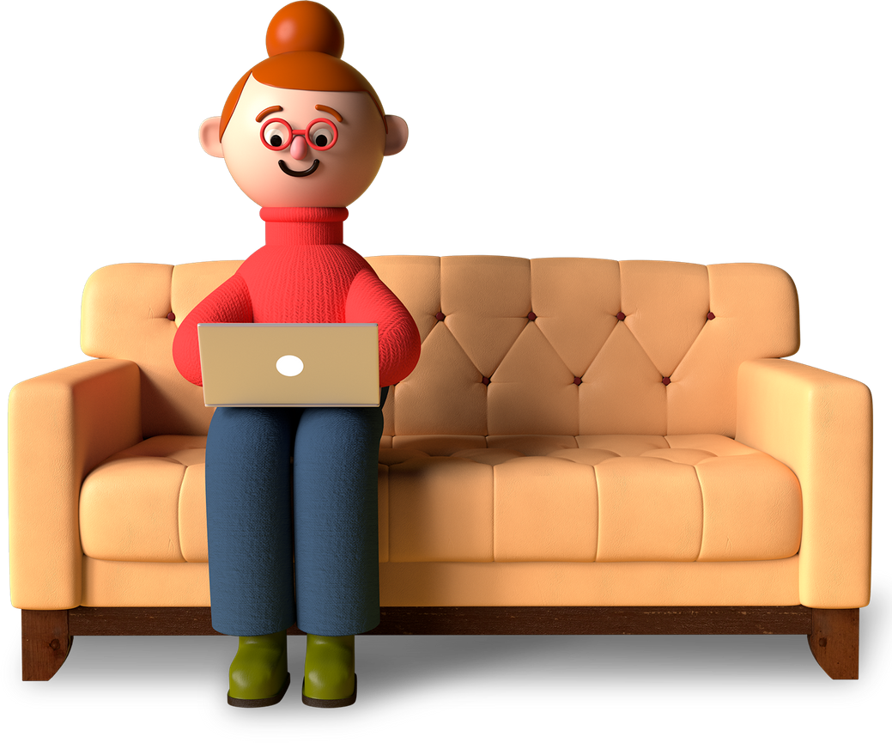
What I learned from it
01
How to create a multimedia game
02
Working on code.org
03
Understanding responses to logic-based code

Slide 6
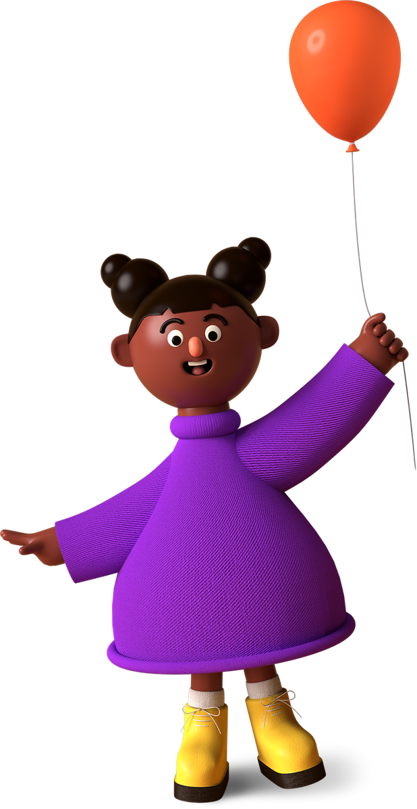
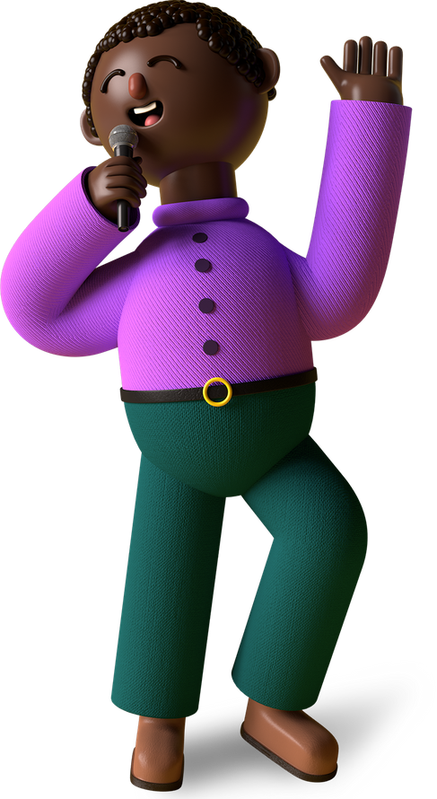
Thank You!
Merry X’Mas & A Happy New Year
From (Student Name),
A Young Coder In The Making!

